Slide 1
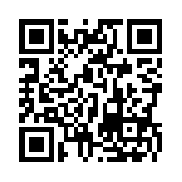
INSTRUCTIONS FOR SIR-II EVALUATION SYSTEM
Step 1: Open your (Washburn) E-mail App (NOT your D2L e-mail)
OR
Log in at http://outlook.washburn.edu
Step 2: Find the e-mail sent on November 20th
from coursevaluations@ets.org
OR
Reset your password at http://sirii.cliksonline.com
Step 3: Go to http://sirii.cliksonline.com and log in with your:
User ID → Your MyWashburn e-mail address
Password → sent to you in the “User Password” E-mail
Step 4: Choose the course you are evaluating and start the survey.

